Slide 1
SoccerNet: Jersey Number Recognition Task
Ghaith Chrit, Tanmaya Karmarkar, Hamza Muhammad Anwar, Karel Joshua Harjono, Amey Karmarkar
Deep Learning 2025
Notes:
Karel

Slide 2
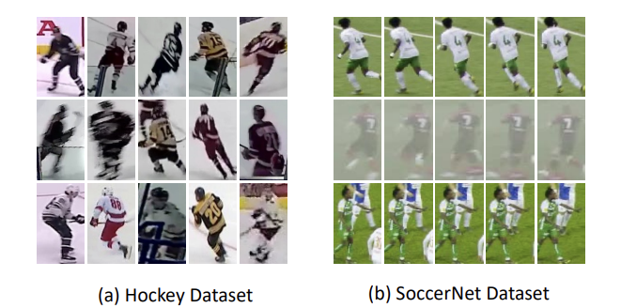
Introduction: Revisiting JNR Problem
Task: Recognize jersey numbers from player tracklets in soccer match videos.
Challenges:
Player Occlusion: Other players block the view of the jersey.
Self-Occlusion (Pose): Player’s arms or body twist hides parts of the number.
Camera Framing: Numbers partially outside the frame due to angle or zoom.
Motion Blur & Lighting: Fast movement or harsh lighting distorts digits.
Jersey Wrinkles: Fabric folds warp or conceal parts of numbers.
Low Resolution: Cropped regions are small, reducing digit clarity.
[Koshkina & Elder, 2024]

Slide 3
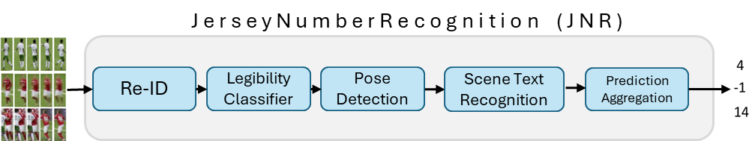
SoccerNet Pipeline: Original Pipeline
Notes:
Instead of just showing our pipeline, we’ll simply go through our process of till we get to our final version
We wanted to focus on improving efficiency while still not penalizing accuracy that much.
First thing is that the model seemed to fail to generalize: validation accuracy (95-99%), test accuracy (~87%), challenge (79%)

Slide 4
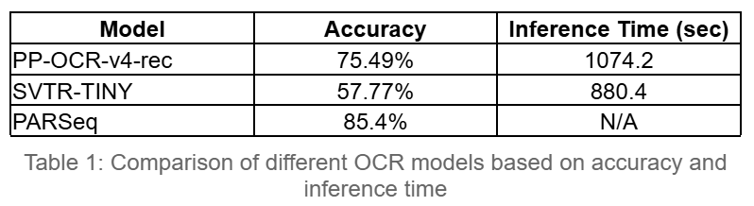
Improving Accuracy: SceneTextRecog
We evaluated whether other more recent off-the-shelf OCR models can outperform chosen STR, PARSeq.
Models Tested:
PP-OCR-v4-rec
SVTR-TINY
Result:
Performance and generalization fell short on the test dataset
Neither model outperformed PARSeq

Slide 5






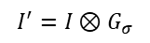
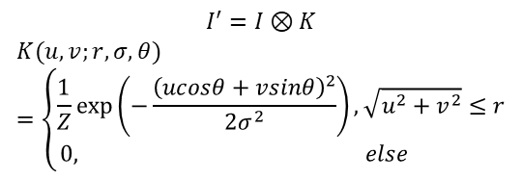
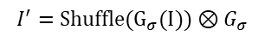
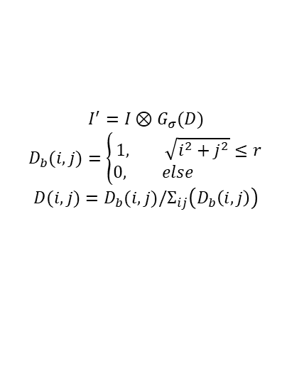
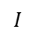
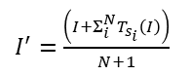
Data Augmentation: Blur
GaussianBlur
GlassBlur
DefocusBlur
ZoomBlur
MotionBlur
$$I$$
$$I^{′}=I⊗G_{σ}$$
$$I^{′}=Shuffle(G_{σ}(I))⊗G_{σ}$$
$$I^{′}=I⊗G_{σ}(D)$$
$$D_{b}(i,j)=\left\{\begin{aligned}1, \sqrt{i^{2}+j^{2}}≤r \\ &0, else \end{aligned}\right.$$
$$D(i,j)=D_{b}(i,j)/Σ_{ij}\left(D_{b}\left(i,j\right)\right)$$
$I^{′}=\frac{\left(I+Σ_{i}^{N}T_{s_{i}}\left(I\right)\right)}{N+1}$
$$I^{′}=I⊗K$$
$$K(u,v;r, σ, θ)=\left\{\begin{aligned}\frac{1}{Z}\exp\left(−\frac{{\left(ucosθ+vsinθ\right)}^{2}}{2σ^{2}}\right), \sqrt{u^{2}+v^{2}}≤r \\ &0, else \end{aligned}\right.$$
Notes:
Ghaith
${T_{s}}_{i}$ denotes the transformation that first zooms the image by a factor $s_{i}$ (using bicubic interpolation) and then crops it centrally back to the original dimensions

Slide 6




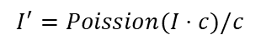
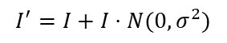
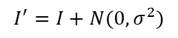
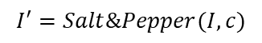
Data Augmentation: Noise
GaussianNoise
ShotNoise
ImpulseNoise
SpeckleNoise
$$I$$
$$I^{′}=I+N(0, σ^{2})$$
$$I^{′}=Poission(I⋅c)/c$$
$$I^{′}=Salt\&Pepper(I, c)$$
$$I^{′}=I+I⋅N(0, σ^{2})$$
Notes:
Gaussian noise manifests in low-lighting conditions.
Shot noise or Poisson noise is electronic noise due to the discrete nature of light itself.
Impulse noise is a color version of salt-and-pepper noise which can be caused by bit errors.
Speckle noise adds fluctuations that scale with the brightness of the image. In dark regions, the noise is less noticeable, while in bright regions, the noise becomes more prominent.

Slide 7





Data Augmentation: Weather
Fog
Snow
Frost
Rain
Shadow
$$I$$

Slide 8
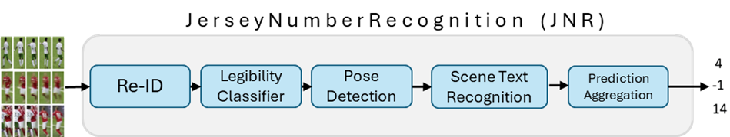
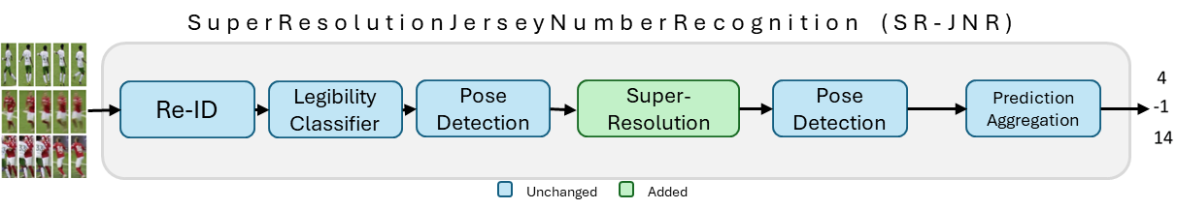
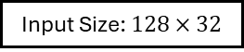
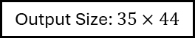
Super Resolution
Output Size: $35×44$
Input Size: $128×32$
Notes:
Aimed to enhance digit clarity in low-res or blurry jersey number crops
SR helps by:
Recovering fine-grained text details
Correcting slight misalignments
Improving readability for OCR models

Slide 9
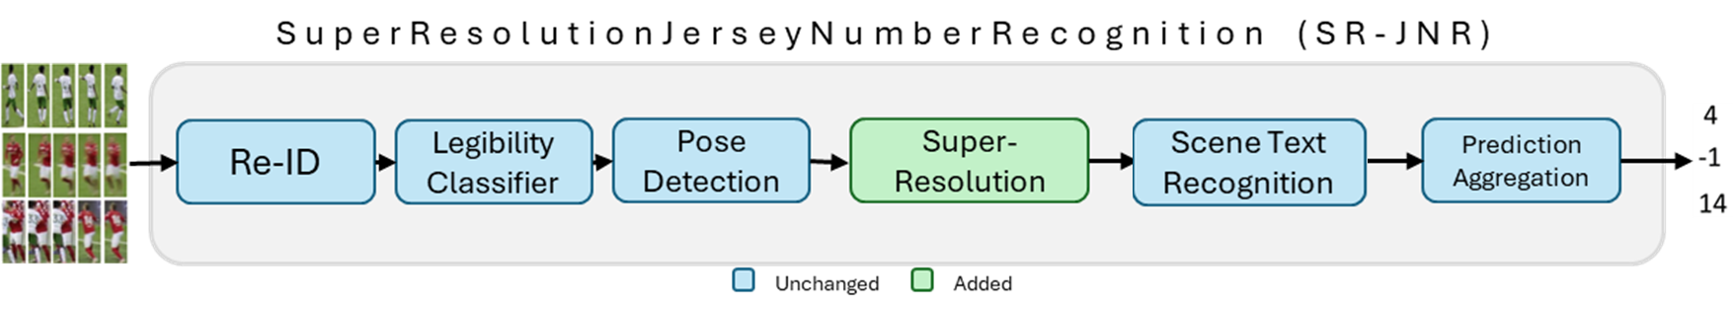
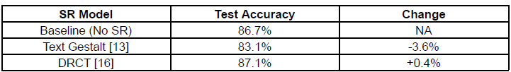
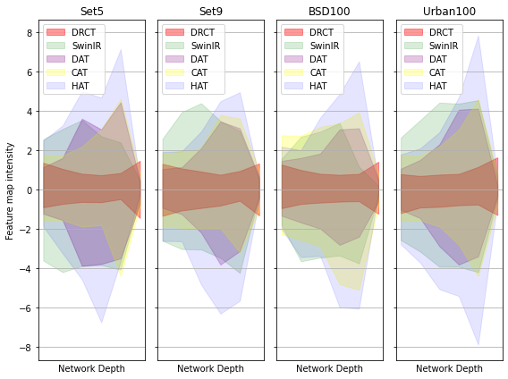
Super Resolution
[Hsu et. al, 2024]
Notes:
Feature map intensities decrease sharply at the end of SR networks, indicating potential information loss while DRCT does not suffer from that case
Models like Text Gestalt are typically trained on certain types of data with specific patterns, textures, resolutions, or noise levels.
If the dataset used in the current pipeline has different features—like unique text styles, noise types, image artifacts, or distortions—then Text Gestalt might struggle to process and enhance the images effectively.

Slide 10
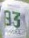






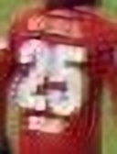


Super Resolution
Original
Text Gestalt
DRCT

Slide 11
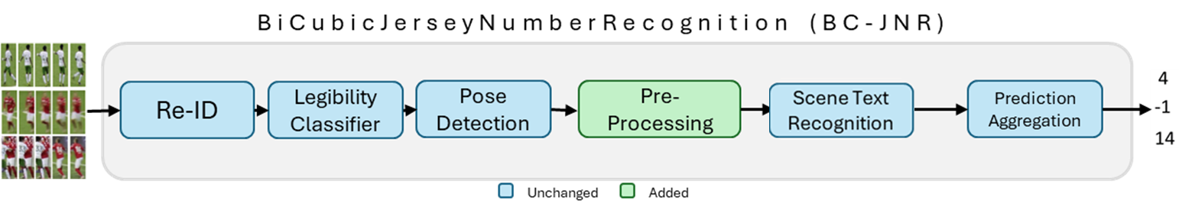
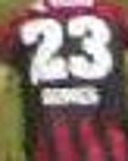


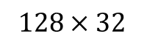
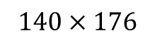
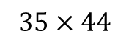
Super Resolution
HPE Output
Bicubic Interpolation
STR Input
$$35×44$$
$$140×176$$
$$128×32$$

Slide 12
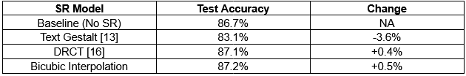
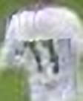
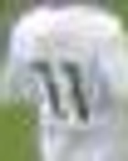
Super Resolution
DRCT
Bicubic
Predicted:
17
11

Slide 13
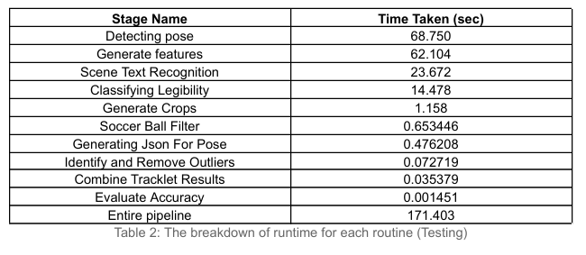
Performance Analysis
*The performance was measured on an HPC with AMD EPYC 7742 64-Core Processor with 256 threads and a single NVIDIA A100-SXM4-80GB GPU
Notes:
Amey

Slide 14
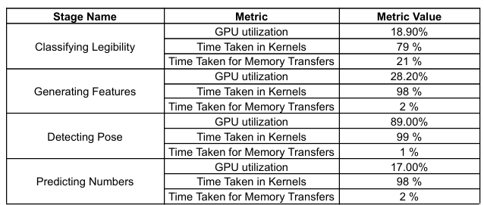
GPU Utilization
*The performance was measured on an HPC with AMD EPYC 7742 64-Core Processor with 256 threads and a single NVIDIA A100-SXM4-80GB GPU

Slide 15
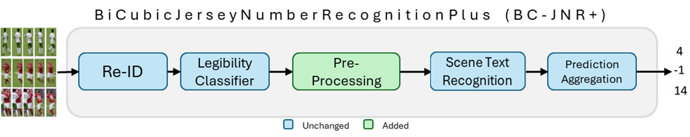
Removing HPE

Slide 16
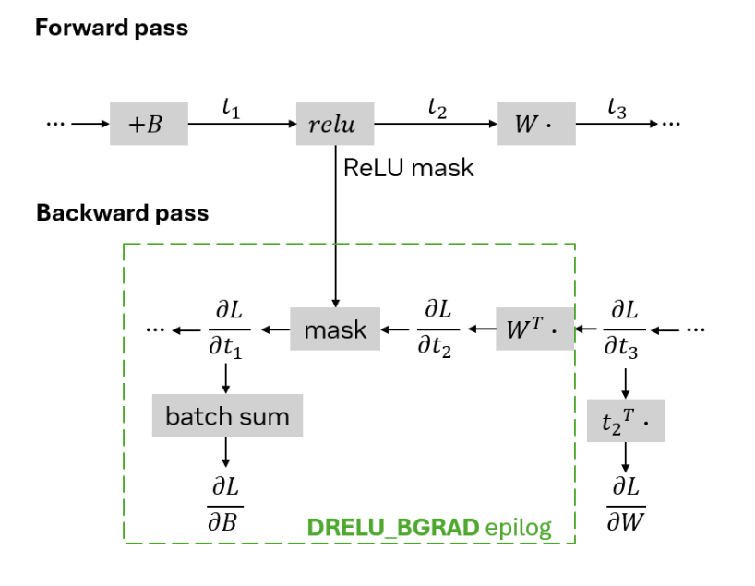
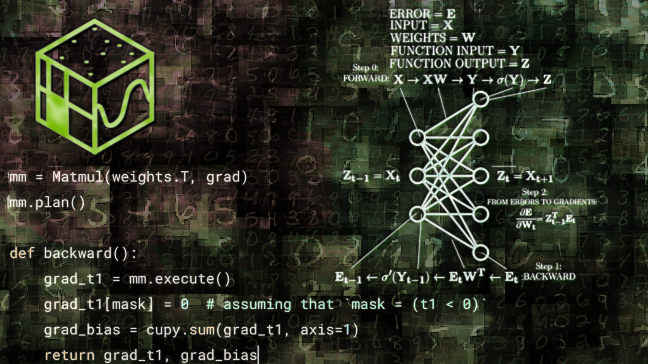
Further Improvements
Fusing Epilog Operations with Matrix Multiplication: Using nvmath-python
[Karpiński, 2024]
Notes:
Tanmaya

Slide 17
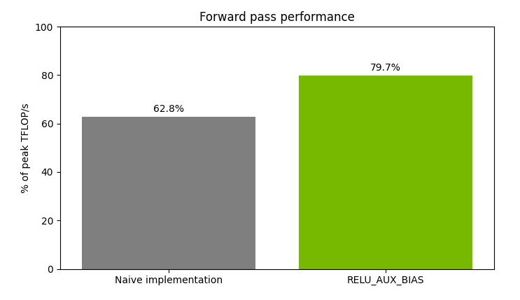
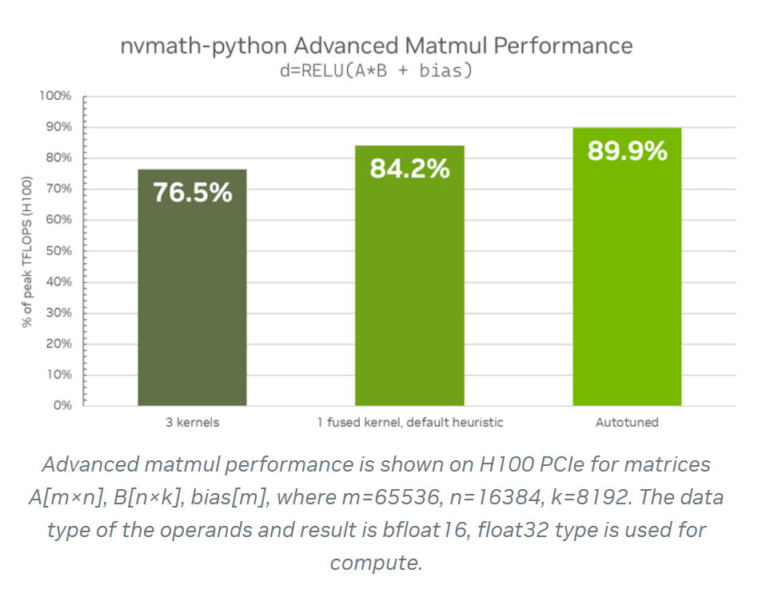
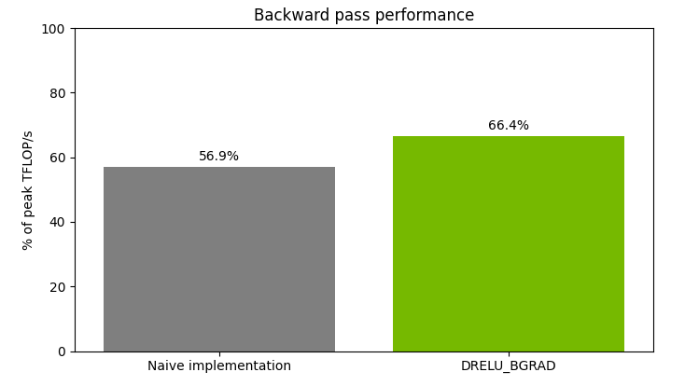
Further Improvements
nvmath-python | NVIDIA Developer

Slide 18
Streaming
copy
compute
copy

Slide 19
Streaming
copy
compute
copy
…total application time will be even less
copy
compute
copy
copy
Generating Features | Improvement
Speed up | 2X
GPU utilization | 28.2% 50%
compute
copy

Slide 20
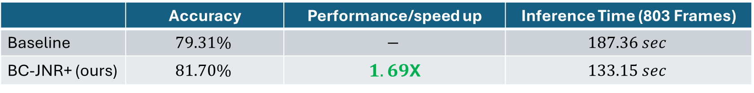


Final Result: Challenge Dataset
 | Accuracy | Performance/speed up | Inference Time (803 Frames)
Baseline | $$79.31\%$$ | $$−$$ | $$187.36 sec$$
BC-JNR+ (ours) | $$81.70\%$$ | $1.69$X | $$133.15 sec$$
$$+2.39\%$$
$$+28.93\%$$
*The performance was measured on an HPC with AMD EPYC 7742 64-Core Processor with 256 threads and a single NVIDIA A100-SXM4-80GB GPU
Notes:
Hamza

Slide 21
Challenges
Installations: The original codebase was outdated, requiring downgrading libraries (e.g., CUDA) or modifying code for compatibility. The ViTPose module was especially difficult to adapt. Each pipeline component had to be run in separate environments, adding complexity.
System Resources: The multi-part framework demanded high computational power, which not all team members had access to, limiting collaboration and slowing experimentation.
Time Constraints: Significant time was spent just replicating the baseline framework, delaying the opportunity to analyze and optimize individual pipeline components.
Technical Documentation: We faced challenges navigating poorly documented dependencies, with some tools lacking version info or having documentation only available in non-English languages, which slowed development and troubleshooting.

Slide 22
LIVE DEMO

Slide 23
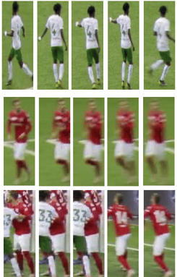
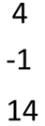
Future Work
SuperResolutionJerseyNumberRecognitionPlus (SR-JNR+)
Super-Resolution
Scene Text Recognition
Text Encoder
c
Text Decoder
NV-Math
NV-Math
Re-ID
Legibility Classifier
Pose Detection
Shallow Feature Extraction
RDG
RDG
RDG
Image Reconstruction
Prediction Aggregation
Image Encoder
Image Decoder
Unchanged
Added
Modified
c
Concatenate
SuperResolutionJerseyNumberRecognitionPlusPlus (SR-JNR++)
Super-Resolution
Scene Text Recognition
Text Encoder
c
Text Decoder
NV-Math
NV-Math
Re-ID
Legibility Classifier
Shallow Feature Extraction
RDG
RDG
RDG
Image Reconstruction
Prediction Aggregation
Image Encoder
Image Decoder
Unchanged
Added
Modified
c
Concatenate
Shift entire codebase to nvmath
Increase GPU utilization
Merge modules to reduce I/O ops
Fine tune SR with STR
Test Lanczos Interpolation
Notes:
Due to lack of time, we could not test the following variations of the model, but we keep it as proposed future works
1. Fine tune the STR and SR end to end
2. Remove pose detection
3. Nvmath instead of numpy – works on both GPU/CPU unlike numpy
NVIDIA might shift it to HW too
We can read do all processing at one go instead of multiple reads
Avoid transferring b/w GPU & CPU
Lanczos provides a smoother interpolation compared to bicubic interpolation

Slide 24
References
J. Chen, H. Yu, J. Ma, B. Li, and X. Xue, “Text Gestalt: Stroke-Aware Scene Text Image Super-resolution,” Proc. AAAI Conf. Artif. Intell., vol. 36, no. 1, Art. no. 1, Jun. 2022, doi: 10.1609/aaai.v36i1.19904.
C.-C. Hsu, C.-M. Lee, and Y.-S. Chou, “DRCT: Saving Image Super-Resolution away from Information Bottleneck,” in 2024 IEEE/CVF Conference on Computer Vision and Pattern Recognition Workshops (CVPRW), Jun. 2024, pp. 6133–6142. doi: 10.1109/CVPRW63382.2024.00618.
Y. Du et al., “SVTR: Scene Text Recognition with a Single Visual Model,” arXiv, 2022.
doi: 10.48550/ARXIV.2205.00159.
D. Bautista and R. Atienza, “Scene Text Recognition with Permuted Autoregressive Sequence Models,” Jul. 14, 2022, arXiv: arXiv:2207.06966. doi: 10.48550/arXiv.2207.06966.
M. Koshkina and J. H. Elder, “A General Framework for Jersey Number Recognition in Sports Video,” 2024, arXiv. doi: 10.48550/ARXIV.2405.13896.
“PP-OCRv4技术报告 - PaddleOCR Documentation.” Accessed: Feb. 27, 2025. [Online]. Available: https://paddlepaddle.github.io/PaddleOCR/main/en/ppocr/blog/PP-OCRv4_introduction.html
S. Karpiński, “Fusing epilog operations with matrix multiplication using nvmath-python,” NVIDIA Technical Blog, https://developer.nvidia.com/blog/fusing-epilog-operations-with-matrix-multiplication-using-nvmath- python/ (accessed Mar. 31, 2025).

Slide 25
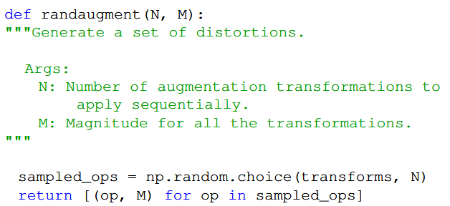
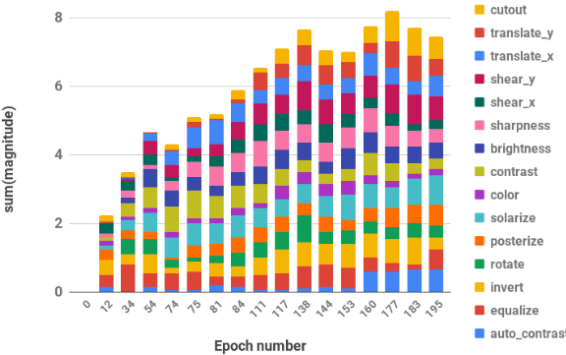
Appendix: RandAug
[Cubuk et. al, 2020]
[Ho et. al, 2019]
D. Ho, E. Liang, I. Stoica, P. Abbeel, and X. Chen, ‘Population Based Augmentation: Efficient learning of augmentation policy schedules’, arXiv [cs.CV], 14-May-2019.
E. D. Cubuk, B. Zoph, J. Shlens, and Q. V. Le, “Randaugment: Practical Automated Data Augmentation with a reduced search space,” 2020 IEEE/CVF Conference on Computer Vision and Pattern Recognition Workshops (CVPRW), Jun. 2020. doi:10.1109/cvprw50498.2020.00359
Notes:
Left:
To reduce the parameter space further, we observe that the learned magnitude for each transformation follows a similar schedule during training and postulate that a single global distortion M may suffice for parameterizing all transformations.
Right:
When ran using a population-based algorithm, operation magnitudes increase rapidly in the initial phase of training, eventually reaching a steady state around epoch 130.

Slide 26
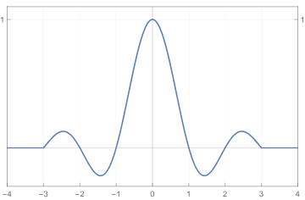
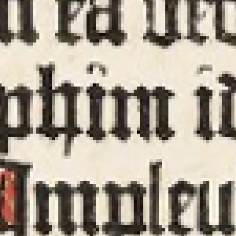
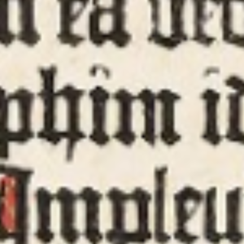

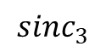
Appendix: Lanczos Interpolation
$$sinc_{3}$$
Nearest
Bilinear
Lanczos
[Mazzoli, 2022]
F. Mazzoli, “Lánczos interpolation explained,” mazzo.li, https://mazzo.li/posts/lanczos.html (accessed Mar. 31, 2025)
Notes:
Interpolate by convolving with a cardinal sinusoidal function: provides a smoother result compared to bicubic
Similar to how a linear interpolation is a convolution with a triangle function

